Slide 1

Latex简要教程
王津

Slide 2
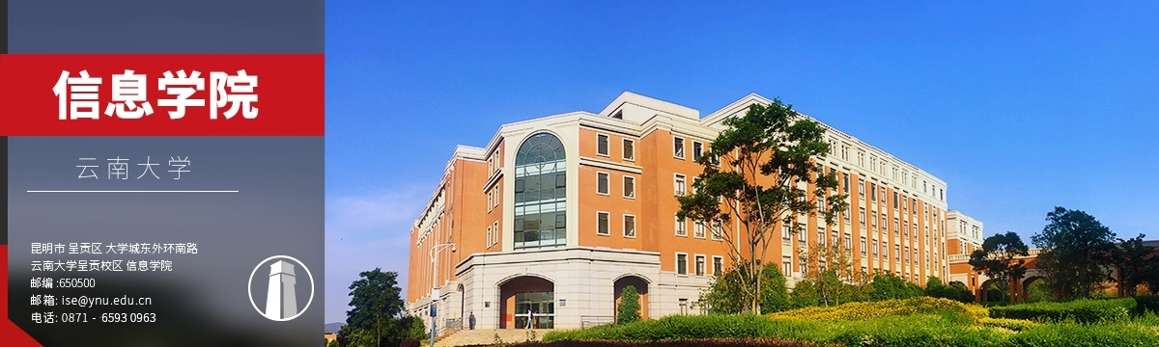
1
Latex简要教程
2
MathType与公式
3
Mendeley与参考文献
4
使用模板
Notes:
按照脚本修改，在右边添加云大和信息学院图案

Slide 3

01
Latex简要教程

Slide 4
Latex
What is LaTeX?
Why use LaTeX?
LaTeX, which is pronounced «Lah-tech» or «Lay-tech» (to rhyme with «blech»), is a document preparation system for high-quality typesetting. It is most often used for medium-to-large technical or scientific documents but it can be used for almost any form of publishing.
LaTeX is free, multiplatform.
LaTeX is just a text document (which can be opened by any text editor), readily converted to PDF.
LaTeX separates content and style. Style once, then focus on content.
The workflow is faster compared to MS Word.
LaTeX is widely used for scientific topics.
LaTeX is simply the best option when it comes to typesetting math expressions.

Slide 5
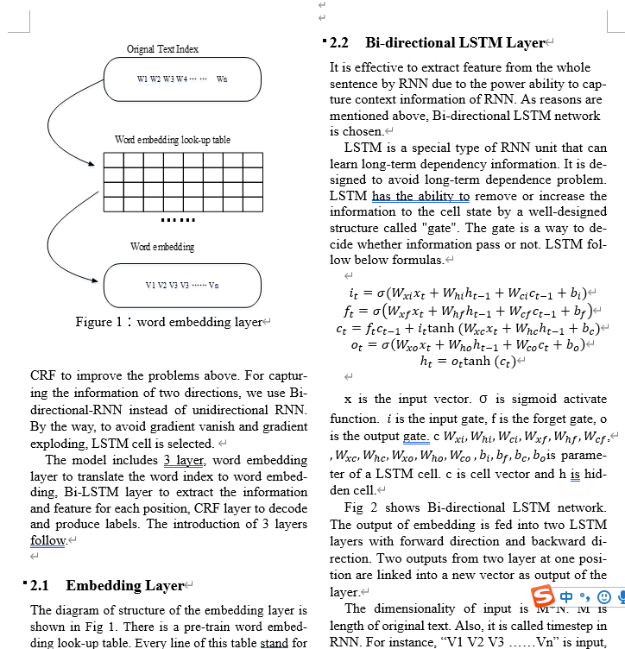
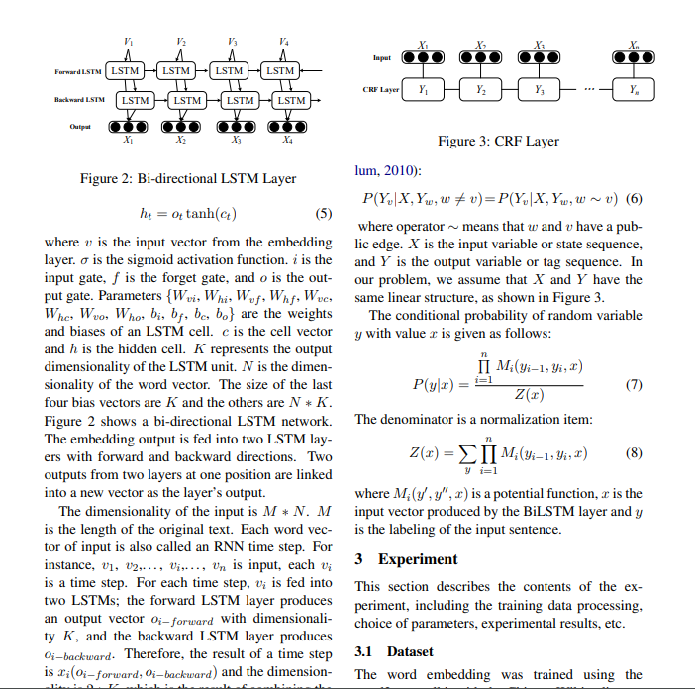
Latex
Which paper do you think is more acceptable?

Slide 6
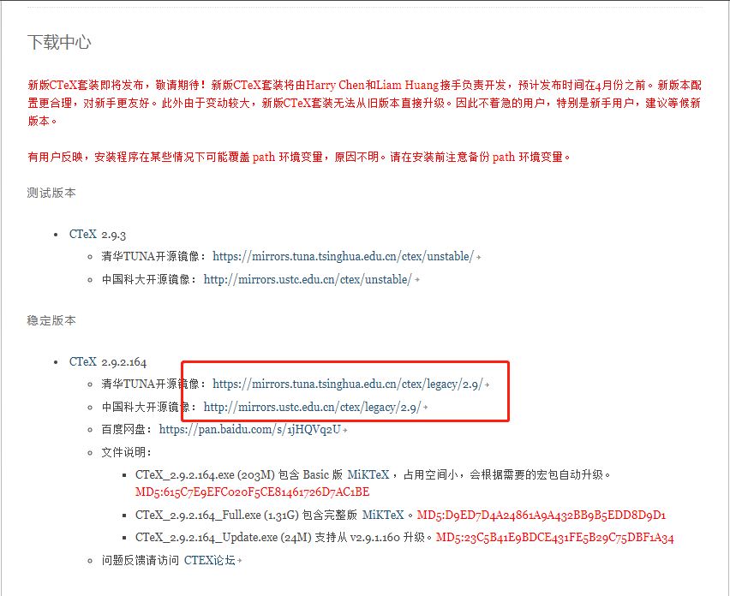
Installation
CTEX is the best solution for using both English and Chinese.
http://www.ctex.org/CTeXDownload

Slide 7
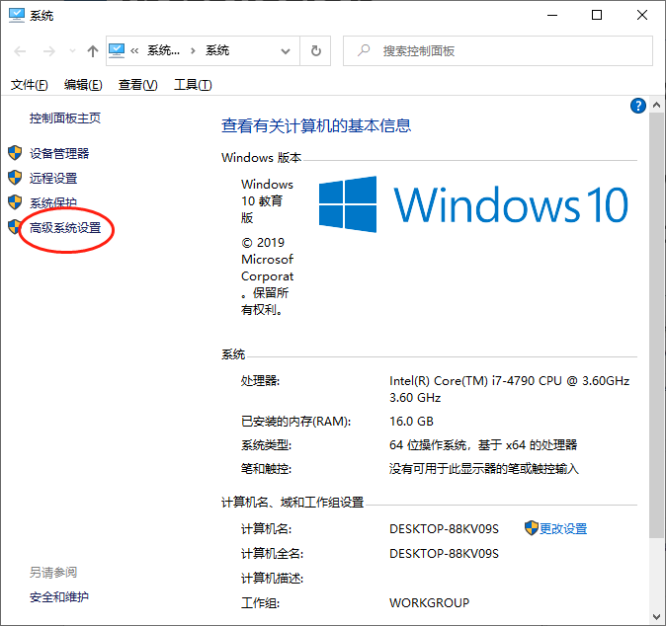
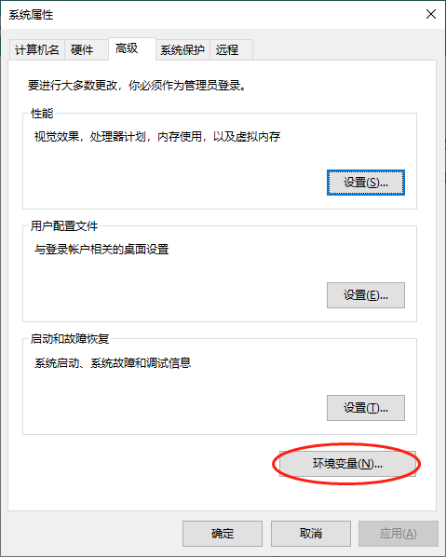
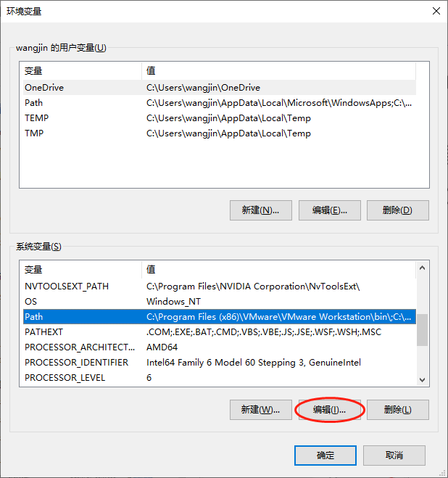
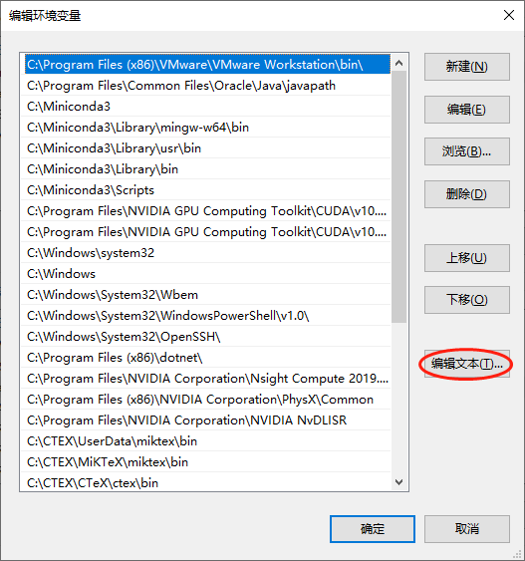
Installation
Before installation, you should backup your system PATH environment variable
右键“我的电脑”->点击“属性”->点击“高级系统设置”->点击“环境变量”->在系统变量中找到“PATH”->全选后复制粘贴到一个新建文本中。

Slide 8
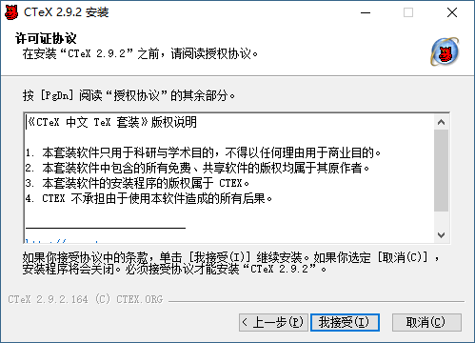
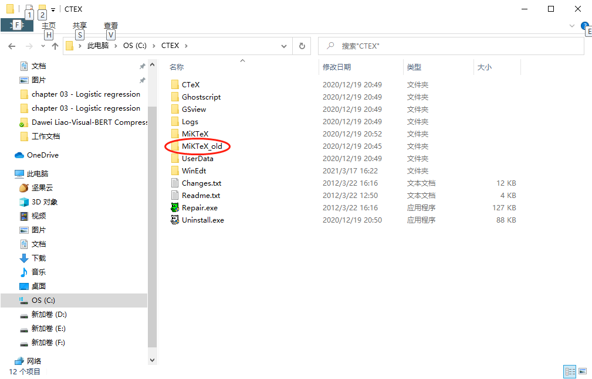
Installation
默认安装即可。
安装完成，将文件夹下的MikTex文件夹更名为MikTex_old（备份）
安装新版本的MikTex（更新）

Slide 9
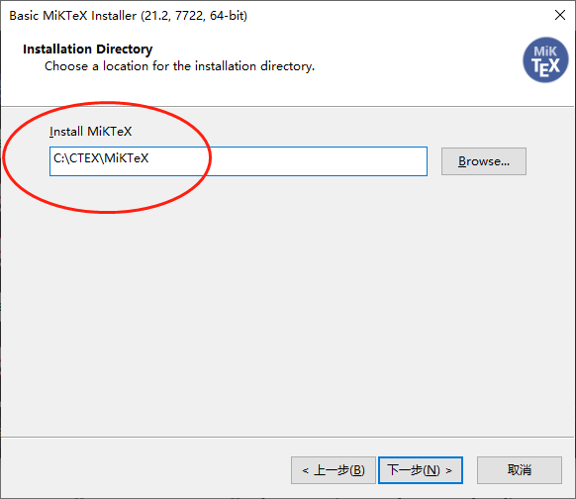
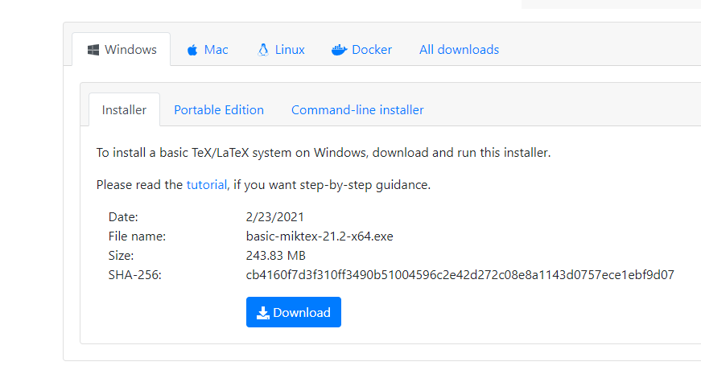
Installation
更新MikTex工具
https://miktex.org/download

Slide 10
First Latex File
Let's write the traditional Hello World in LaTeX.
If you have installed CTEX, first open Winedt create a new file with ending .tex.
Then type in the following code below to render "Hello World!" and run “PDFTexify".
\documentclass[a4paper]{article}
\begin{document}
Hello World ! % This is your content
\end{document}

Slide 11
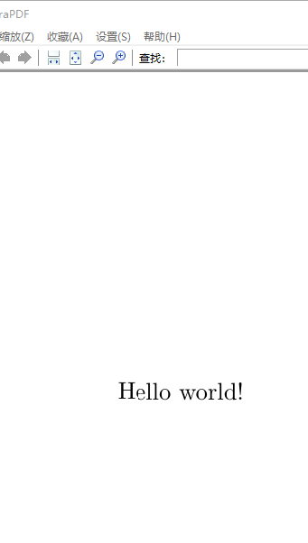
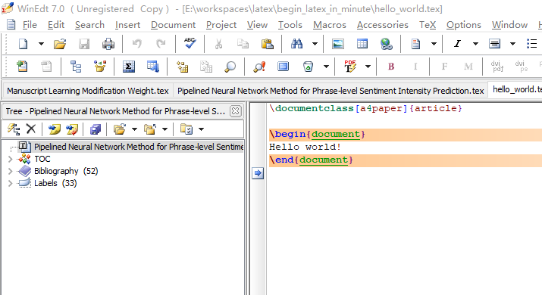
First Latex File

Slide 12
First Latex File
A deeper look into your first LaTeX file easily shows that:
The first line tells the Interpreter that you are working on an article with the size of the a4. Other types of document you might be working with in the future are report, book... and so on.
A document is wrapped by the \begin{document} and \end{document}. Think of this as the heart of the document, as the main() in java or C++... without which the document can't be rendered.
The part between begin and end ( which, in this case, is Hello World ) is simply your own content.
A percent sign (%) denotes your comment, which LaTeX will ignore.

Slide 13

First Latex File
Attention
Looking back at \begin{document}, \end{document}, \documentclass[a4paper]{article}. You may notice the pattern now. These are called Typesetting Commands ( which are usually preceded by “\” ) and arguments ( placed inside curly braces “{}” ). LaTeX are basically normal texts, but powered by these commands.
While you are following this guide, everything will work smoothly. However, in the future, should there be any problems, don't panic. The error reports are human-friendly and readable. If you can't resolve them, a search tool like Google may be your best friend.
Some characters are predefined with special meanings in LaTeX. You may want to use backslashes (\) in front of these characters for proper output.

Slide 14
Chinese Usage
A tricky situation is dealing with Chinese in Latex. Here, usepackage{CJKutf8} with \begin{CJK}{UTF8} and \end{CJK} comes in very handy. Here's Chinese example:
\documentclass[a4paper]{article}
\usepackage{CJKutf8}
\begin{document}
\begin{CJK}{UTF8}{min}
这是一行中文字%Thank you for reading this article.
\end{CJK}
\end{document}

Slide 15
Lists
It is very important to organize your document well. Thus, let's start by putting your items into a list.
Two common types of lists are unordered and ordered list. Each of them can be handled with ease in LaTeX document:
Unordered List Unordered list only needs "itemize".
(pun intended)
Ordered List Ordered list, however, need us to
"enumerate" them. (pun intended)
\begin{itemize}
\item Item.
\item Another Item.
\end{itemize}
\begin{enumerate}
\item First Item.
\item Second Item.
\end{enumerate}

Slide 16
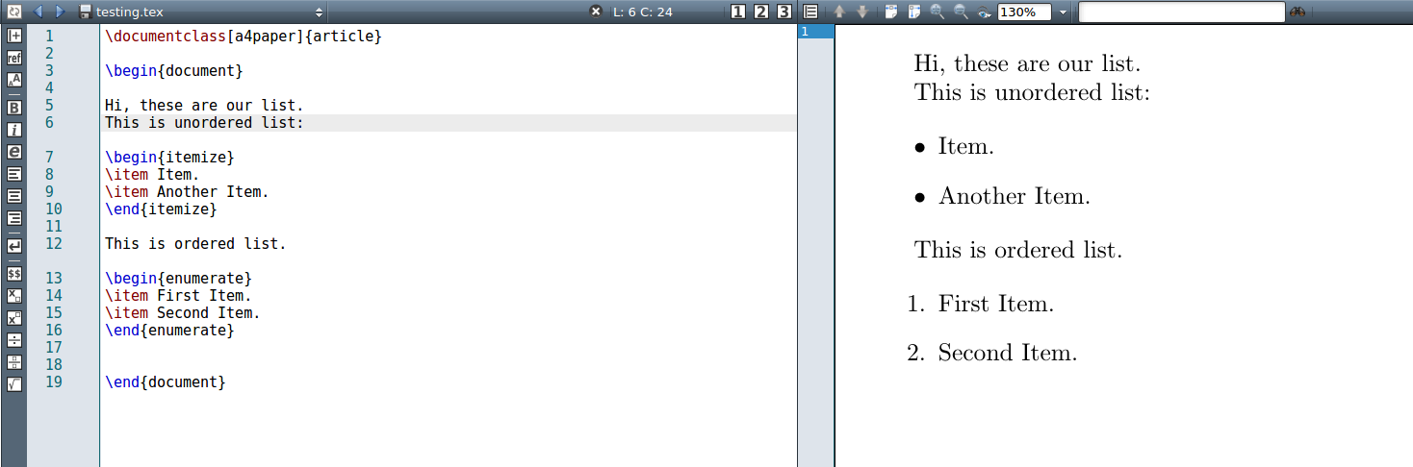
Lists
Here's how two types of list display in the output:

Slide 17
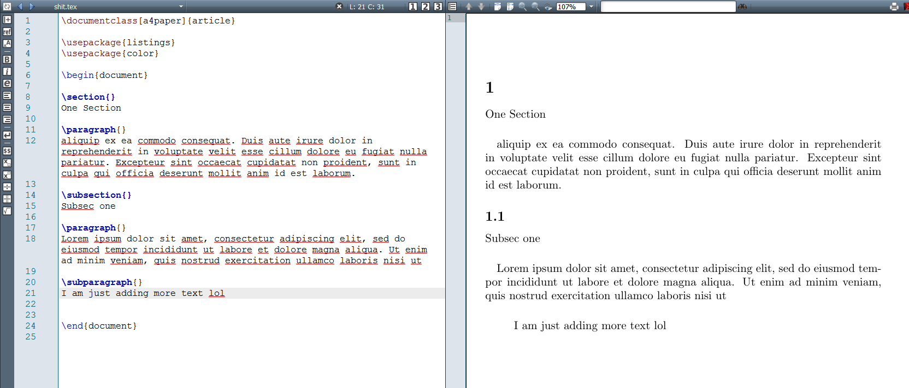
Paragraph and section
We begin a section with \section and a paragraph with \paragraph.
You can also add subsection with \subsection and subparagraph with \subparagraph

Slide 18
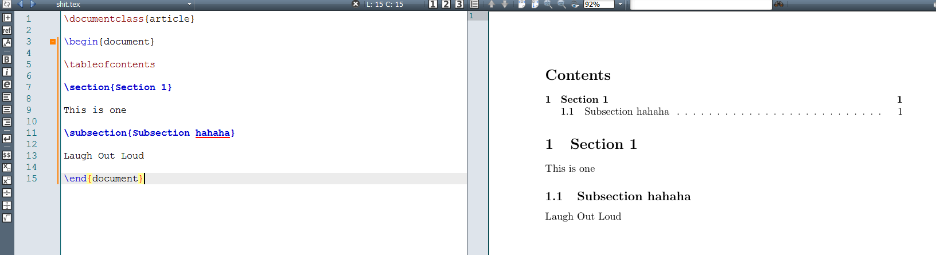
Making a table of contents
It's useful to open sections and subsections with a \tableofcontents
you can use \newpage if you want to make a new page.

Slide 19
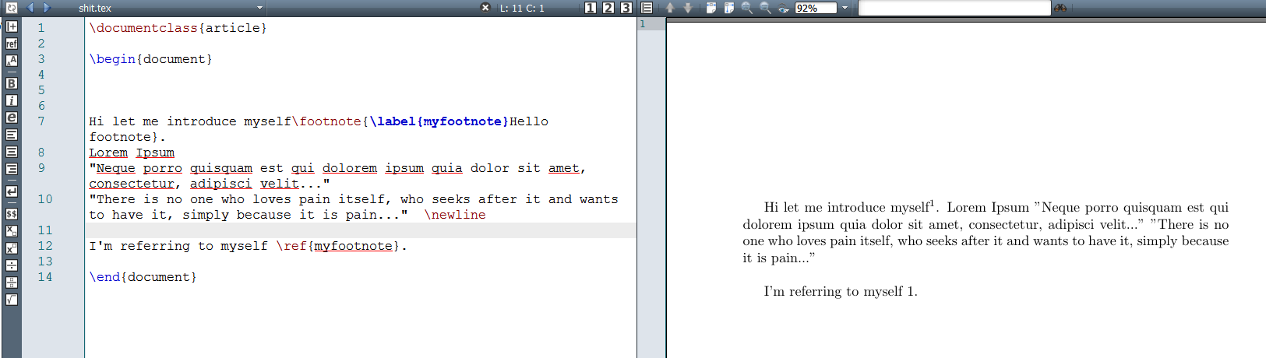
Footnotes
It's as easy as pie to use footnote+label+ref to make all kinds of footnotes you want. For example:
Hi let me introduce myself\footnote{\label{myfootnote}Hello footnote}.
... (later on)
I'm referring to myself \ref{myfootnote}.

Slide 20
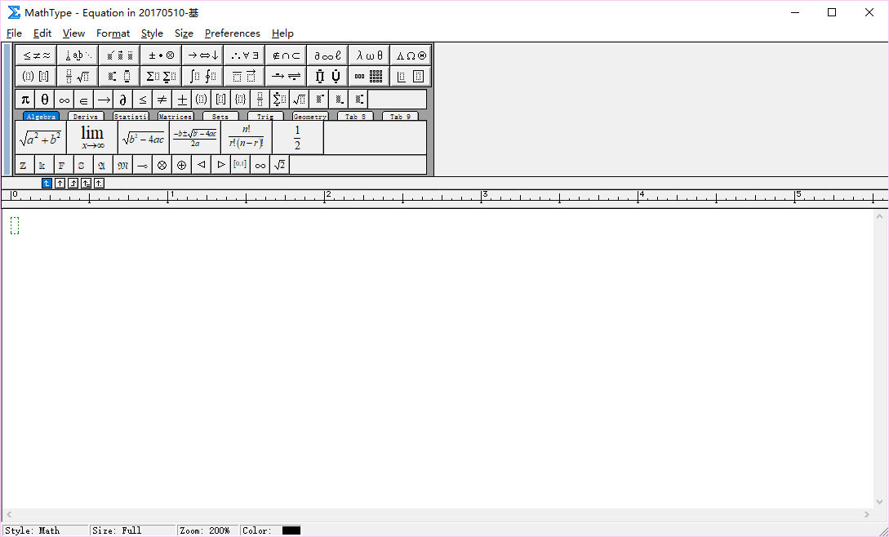
Equations
Create Equations with MathType
http://www.mathtype.cn/

Slide 21
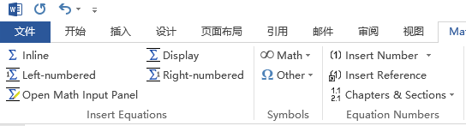
Equations
Open Word, you will find a new toolbar option
Inline
Display
Left-numbered
Right-numbered

Slide 22
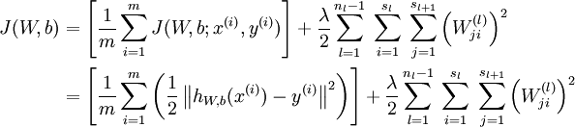
Equations
Click “Display” or “Right-numbered”
Try to display the formulation of loss function of a neural network.

Slide 23
Equations
Formulations in Latex
Inline $$
E.g. $X \in {\Re ^d}$
Right-numbered
\begin{equation}
X \in {\Re ^d}
\label{eq:1}
\end{equation}

Slide 24
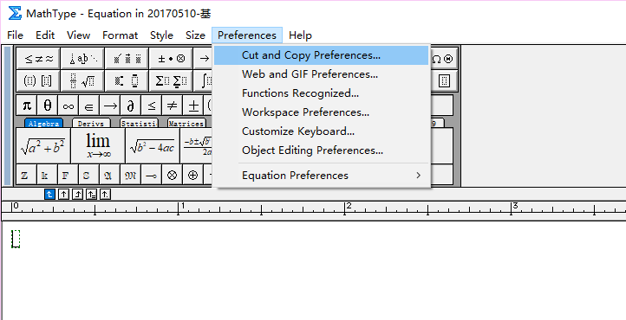
Equations
Convert the MathType formulation into Latex

Slide 25
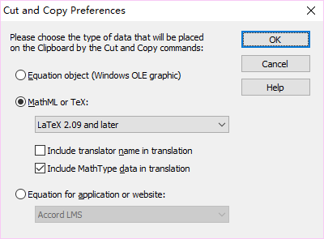
Equations
Convert the Mathtype formulation into Latex
Select the formulation in Mathtype. Copy and paste in Latex
Delete all comments and \[ \]
% MathType!MTEF!2!1!+-
% feaagKart1ev2aqatCvAUfeBSjuyZL2yd9gzLbvyNv2CaerbuLwBLn
% hiov2DGi1BTfMBaeXatLxBI9gBaerbd9wDYLwzYbItLDharqqtubsr
% 4rNCHbWexLMBbXgBd9gzLbvyNv2CaeHbl7mZLdGeaGqik8vrps0lbb
% f9q8WrFfeuY-Hhbbf9v8qqaqFr0xc9pk0xbba9q8WqFfea0-yr0RYx
% ir-Jbba9q8aq0-yq-He9q8qqQ8frFve9Fve9Ff0dmeaabaqaciGaca
% GaaeqabaWaaeaaeaqbaOqaaiaadIfacqGHiiIZcqGHCeIWdaahaaWc
% beqaaiaadsgaaaaaaa!445E!
$X \in {\Re ^d}$

Slide 26
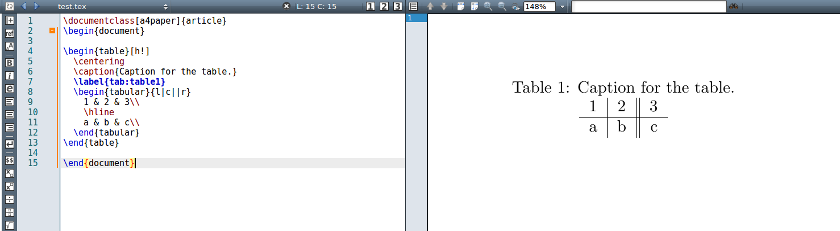
Table
\begin{table}[h!]
\centering
\caption{Caption for the table.}
\label{tab:table1}
\begin{tabular}{l|c||r}
1 & 2 & 3\\ \hline
a & b & c\\
\end{tabular}
\end{table}
A practical example

Slide 27
Table
For tables, first we need a table environment, which is why we have \begin{table} and \end{table}.
You will learn about h! later in the image section. It goes with \centering to keep the table at the center of the page.
Caption is for describing. Label is for tagging. You will see these more in image section.
Tabular is the most important part. A table environment always needs a tabular environment inside.
the part {l|c||r} is where we format the content inside the table. Here we can see:
l or c or r means that the content inside each cell will be left-aligned or center-aligned or right-aligned, respectively.
the vertical slash | or || is actually the format of the vertical lines/borders inside the table's columns.
1 & 2 & 3 => 1 2 3 are the contents of each cells. the ampersand & is used to separate the content of each cell in a row.
a \hline actually adds a horizontal line to separate each row.

Slide 28
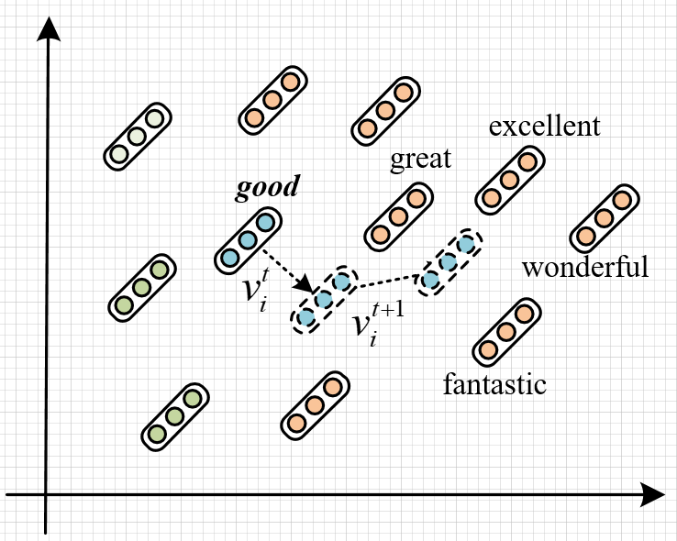
Adding Images
Use Visio to generate a paradigm figure
Use Matplotlib in python to generate a result histogram

Slide 29
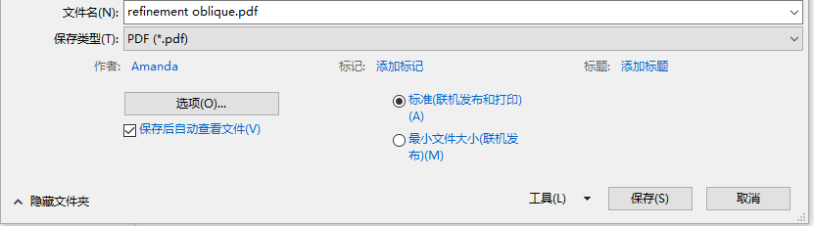
Adding Images
Save as pdf file
Cut into certain shape. (Adobe Acrobat)

Slide 30
Matplotlib
Use Matplotlib to Plot Data
Line
import matplotlib.pyplot as plt import numpy as np x = np.arange(9) y = np.sin(x) z = np.cos(x) # marker数据点样式，linewidth线宽，linestyle线型样式，color颜色 plt.plot(x, y, marker="*", linewidth=3, linestyle="--", color="orange") plt.plot(x, z) plt.title("matplotlib") plt.xlabel("height") plt.ylabel("width") # 设置图例 plt.legend(["Y","Z"], loc="upper right") plt.grid(True) plt.show()

Slide 31
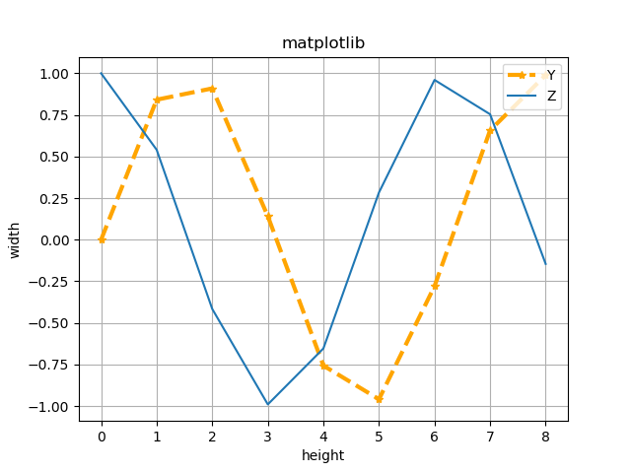
Matplotlib
Click save as
“png” or “jpeg” for word file
“pdf” for latex file

Slide 32
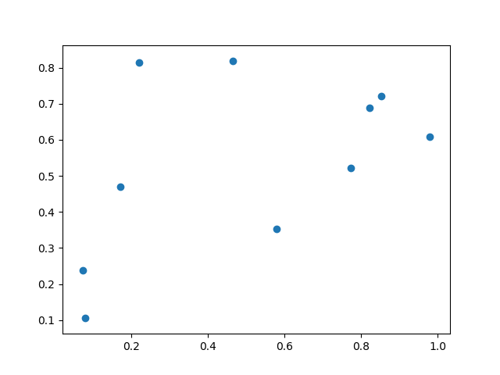
Matplotlib
Scatter plot
import matplotlib.pyplot as plt import numpy as np x = np.random.rand(10) y = np.random.rand(10) # x = (1.0, 2.0, 3.0,) # y = (11.1, 2.23, 3.14,) plt.scatter(x,y) plt.show()

Slide 33
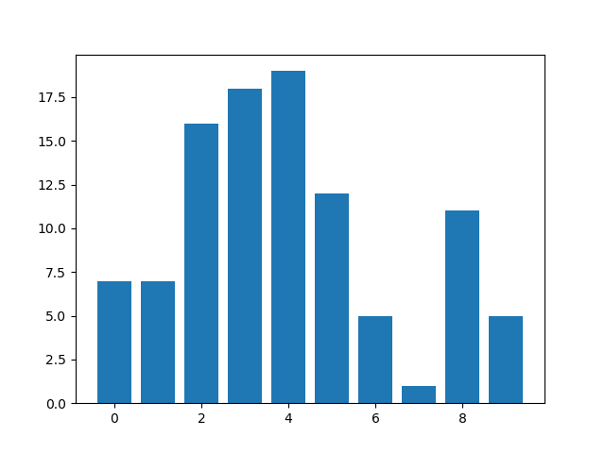
Matplotlib
Bar plot
import matplotlib.pyplot as plt import numpy as np x = np.arange(10) y = np.random.randint(0,30,10) plt.bar(x, y) plt.show()

Slide 34
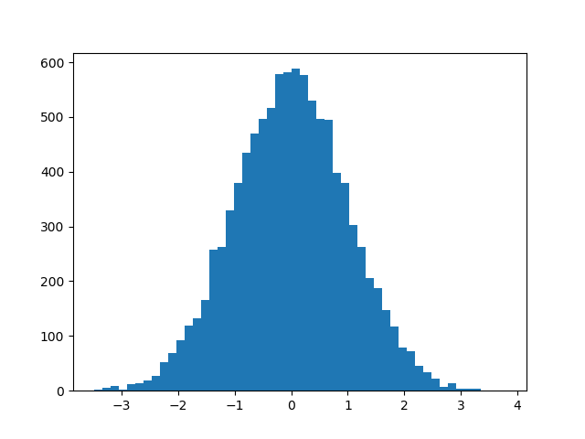
Matplotlib
Histogram
import matplotlib.pyplot as plt import numpy as np mean, sigma = 0, 1 x = mean + sigma * np.random.randn(10000) plt.hist(x,50) plt.show()

Slide 35
Matplotlib
Advanced example - bar
import numpy as np import matplotlib.pyplot as plt font = {'family' : 'Times New Roman', 'color' : 'black',\ 'weight' : 'normal', 'size' : 20} n_groups = 4 means_nn = (0.743, 0.720, 0.913, 0.900) means_ecnu = (0.734, 0.686, 0.884, 0.845) means_uwb = (0.644, 0.657, 0.846, 0.849) means_lsis = (0.421, 0.324, 0.599, 0.462) fig, ax = plt.subplots() index = np.arange(n_groups) bar_width = 0.2 opacity = 0.6

Slide 36
Matplotlib
Latex math in xticks and yticks
rects1 = plt.bar(index, means_nn, bar_width, color='b', label='NN', alpha=0.7) rects2 = plt.bar(index + bar_width, means_ecnu, bar_width, color='r', label='L2R (ECNU)', alpha=0.7) rects3 = plt.bar(index + 2 * bar_width, means_uwb, bar_width, color='g', label='GP-Reg (UWB)', alpha=0.7) rects4 = plt.bar(index + 3 * bar_width, means_lsis, bar_width, color='c', label='PMI (LSIS)', alpha=0.7) # plt.xlabel('Metrics', fontdict=font) # plt.ylabel('Scores', fontdict=font) # plt.title('Scores by group and gender') plt.xticks(0.2 + index + bar_width, ('Word\n Kendall\'s $\\tau $',\ 'Phrase\n Kendall\'s $\\tau $', \ 'Word\n Spearman\'s $\\rho $', \ 'Phrase\n Spearman\'s $\\rho $'), family = 'Times New Roman', fontsize=13)

Slide 37
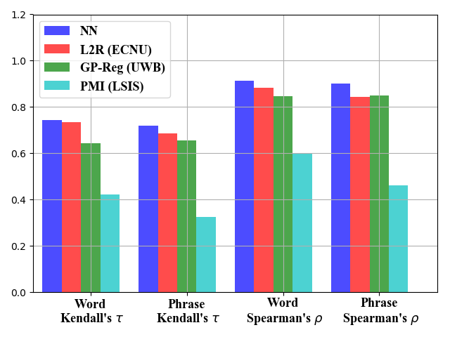
Matplotlib
Advanced Histogram
plt.ylim(0, 1.2) plt.xlim(-0.2, 4.0) plt.legend(prop={'size': 13, 'family': 'Times New Roman'}) plt.tight_layout() plt.grid(True) plt.show()

Slide 38
Matplotlib
Advanced example – Line plot
from __future__ import absolute_import from __future__ import print_function import os import sys import logging from matplotlib import pyplot as plt x_topn = [1, 2, 3, 4, 5] y_binary = [ 88.8, 89, 88.1, 87.2, 86.2] y_finegrained = [64.8, 65.8, 64.5, 61.2, 58.8] font = {'family' : 'Times New Roman', 'color' : 'black',\ 'weight' : 'normal', 'size' : 20} fig = plt.figure()

Slide 39
Matplotlib
Twin - x
ax1 = fig.add_subplot(111) line1, = ax1.plot(x_topn, y_binary, 'rs-', linewidth=2.2, label='Binary') ax1.set_xlim(0.75, 5.25) ax1.set_ylim(85.5, 90.5) ax1.set_ylabel('Binary (Macro-F1)', fontdict=font) ax1.set_xlabel('$\\alpha:\\beta$', fontdict=font) ax1.tick_params(labelsize=16) ax1.set_yticklabels(('', '86.0', '87.0', '88.0', '89.0', '90.0')) ax2 = ax1.twinx() line2, = ax2.plot(x_topn, y_finegrained, 'bh-', linewidth=2.2, label='Ternary') ax2.set_xlim(0.75, 5.25) ax2.set_ylim(56.5, 68.5) ax2.set_ylabel('Ternary (Macro-F1)', fontdict=font) ax2.tick_params(labelsize=16) ax2.set_yticklabels(('', '58.0', '60.0', '62.0', '64.0', '66.0', '68.0'))

Slide 40
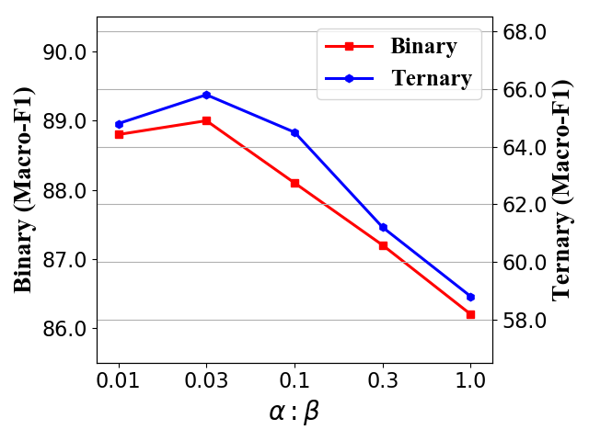
Matplotlib
Twin - x
plt.legend(handles=[line1, line2], prop={'size': 18, 'family' : 'Times New Roman'}, loc='upper right') plt.gca().set_xticklabels(('', '0.01', '0.03', '0.1', '0.3', '1.0')) plt.tight_layout() plt.grid() plt.show()

Slide 41
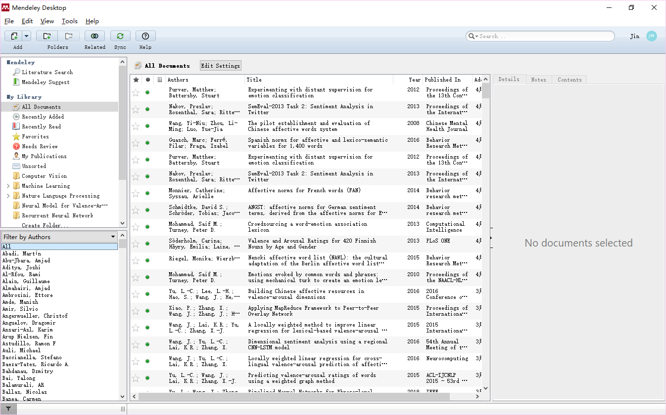
Reference
Mendeley
https://www.mendeley.com/

Slide 42

Reference
Drag a pdf paper to directly generate an item.
Revise manually to correct the information.

Slide 43
Reference
Type
Paper – 学术论文
Journal Article [J]
Conference Proceedings [C]
Book [M] - 学术专著
Book section
Report [R] - 学术报告
Thesis or Dissertation [D] - 学位论文
硕士可称 Thesis
博士可称 Thesis or Dissertation

Slide 44
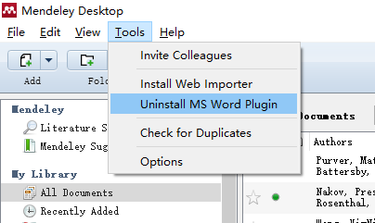
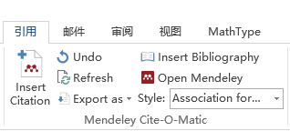
Reference
Install word plugin
Ref in word

Slide 45
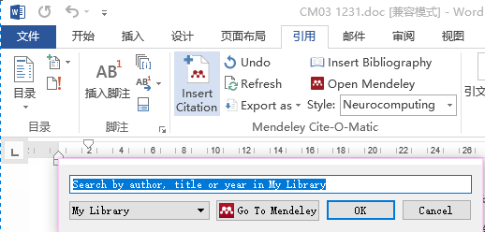
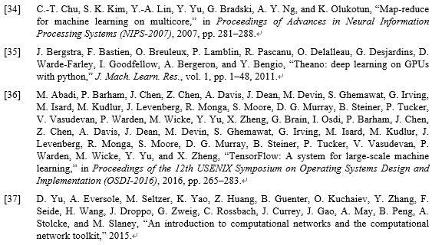
Reference
Click “Insert citation”
Click “Insert Bibliography”

Slide 46
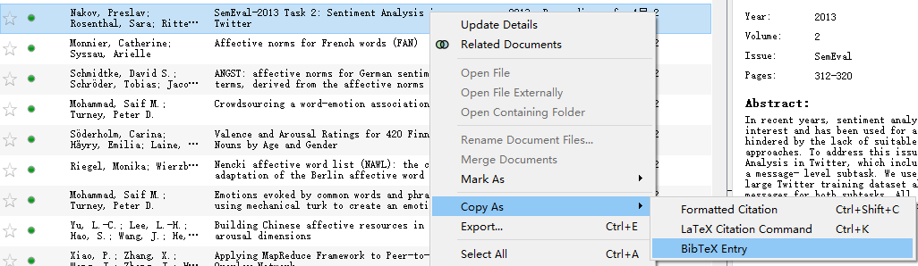
Reference
Latex Format
Save all ref as a bib file

Slide 47
Reference
@inproceedings{Mohammad:2018,
title={Semeval-2018 Task 1: Affect in tweets},
author={Saif M. Mohammad and Felipe Bravo-Marquez and Mohammad Salameh and Svetlana Kiritchenko},
booktitle={Proceedings of International Workshop on Semantic Evaluation (SemEval-2018)},
address = {New Orleans, LA, USA},
year={2018},
month = {June}
}
@inproceedings{Mohammad:2018b,
title={Understanding Emotions: A Dataset of Tweets to Study Interactions between Affect Categories},
author={Saif M. Mohammad and Svetlana Kiritchenko},
booktitle={Proceedings of the 11th Edition of the Language Resources and Evaluation Conference (LREC-2018)},
address = {Miyazaki, Japan},
year={2018},
month = {May}
}
@article{Mohammad2013NRC,
title={NRC-Canada: Building the State-of-the-Art in Sentiment Analysis of Tweets},
author={Mohammad, Saif M and Kiritchenko, Svetlana and Zhu, Xiaodan},
journal={Computer Science},
year={2013},
}

Slide 48
Reference
Including a bib file
Cite a reference in content
\bibliography{style_file}
\bibliographystyle{bib_file}
\cite{Li2008AdaBoost}

Slide 49
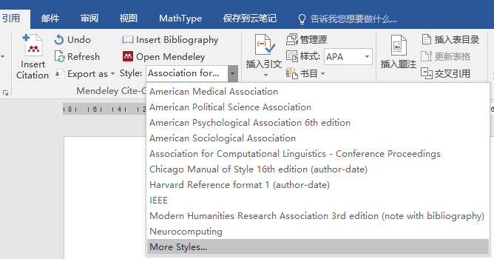
Reference
Import style 1
http://www.zotero.org/styles
Download csl file
Copy to citationStyles-1.0 folder that you install mendeley.
Import style 2
Click “More styles”

Slide 50
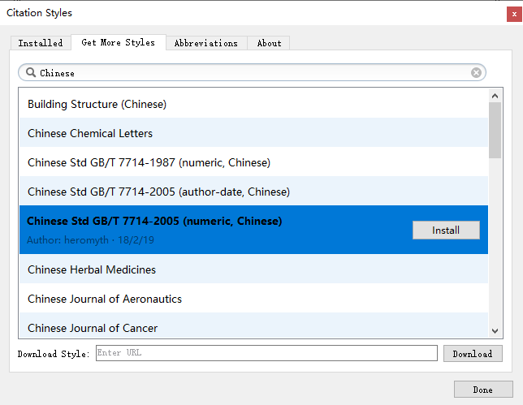
Reference
Get More Styles (毕业论文格式)
Search for “Chinese Std GB/T 7714-2005 (numeric, Chinese)”
For your thesis or journal article in Chinese

Slide 51
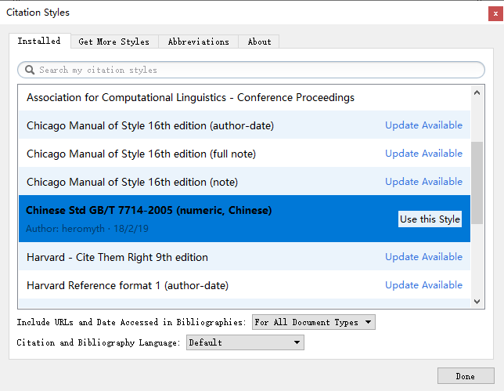
Reference
Click “Installed” tab
Click “Use this Style”

Slide 52
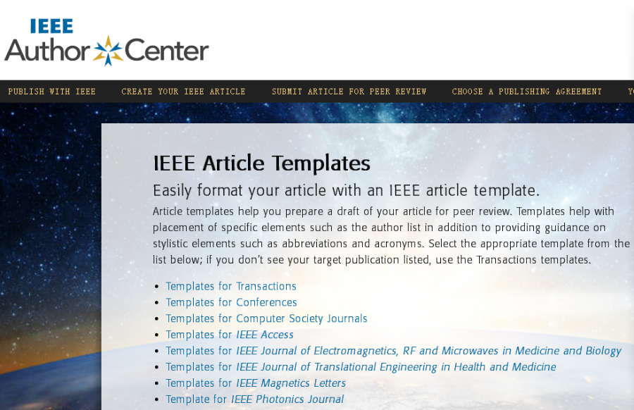
Use a template
Template url:
http://ieeeauthorcenter.ieee.org/create-your-ieee-article/use-authoring-tools-and-ieee-article-templates/ieee-article-templates/
The template will be also provided in every conference.

Slide 53
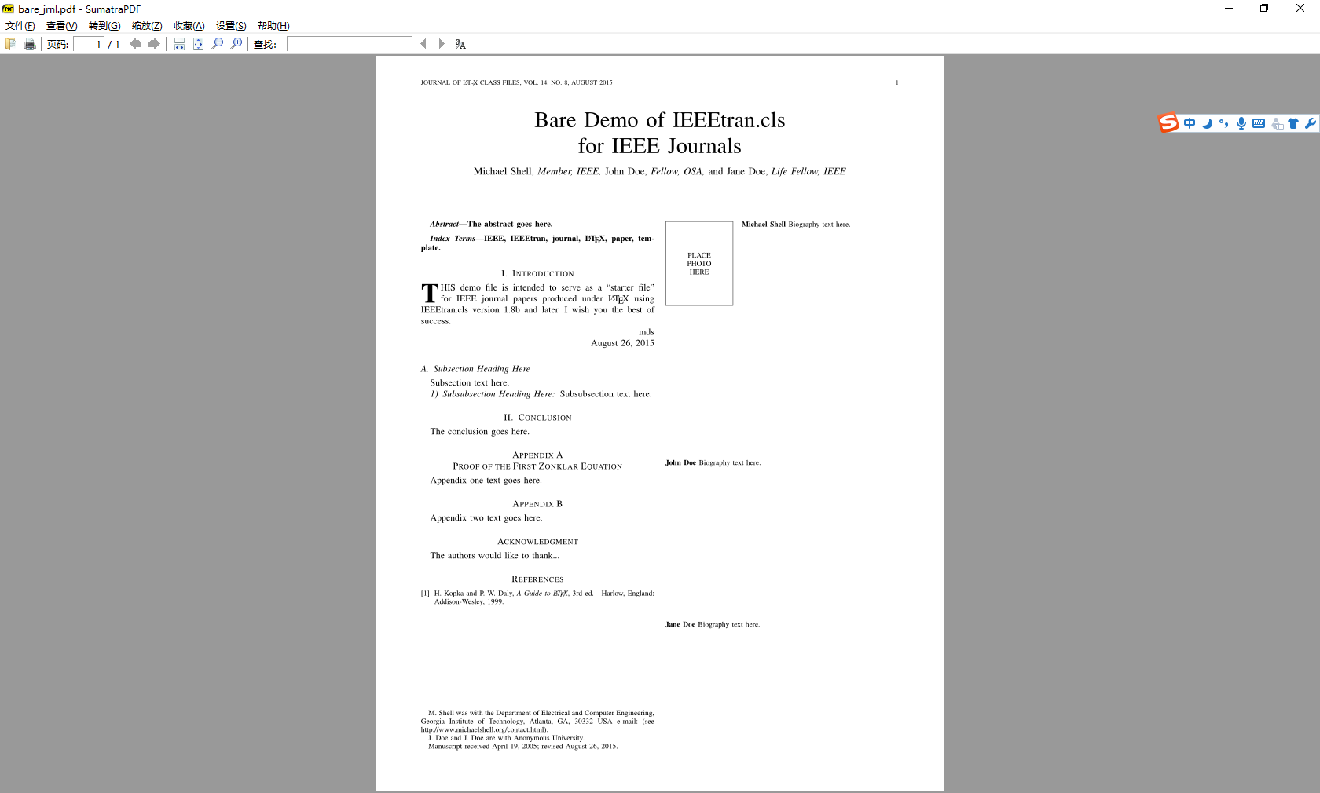
Use a template
For example, down load the IEEE Transaction template.

Slide 54
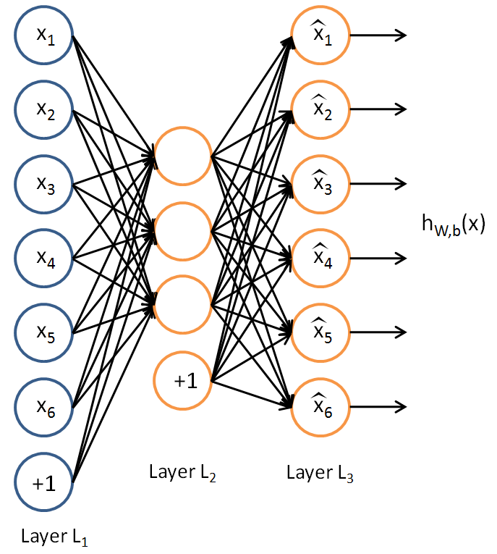
Task
By using the IEEE Trans template, formatting the following content into a scientific article:
http://ufldl.stanford.edu/tutorial/unsupervised/Autoencoders/
Autoencoders

Slide 55
谢谢大家

